Slide 1
In this Lab …
  Data Cleaning and Preprocessing Activity

Slide 2
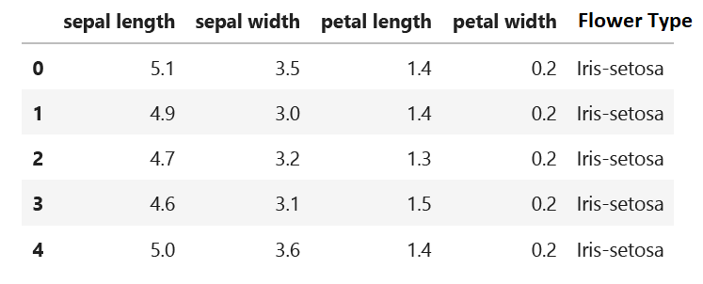

What is a Dataset

Slide 3
What is a Dataset
Variable, Dimension, Feature
Sample,
Observation,
Feature vector

Slide 4
Main Operations
Import the Libraries
Import the dataset (from file, URL)
Dealing with Missing Values
Dealing with Duplicates
Dealing with Categorical values

Slide 5
Using Python Pandas
Pandas is the popular Python library that is mainly used for data processing purposes like cleaning, manipulation, and analysis.
It consists of classes to read, process, and write CSV data files
For more information, visit https://pandas.pydata.org/docs/user_guide/index.html

Slide 6
Install and use Jupyter Notebook
Install Python: https://www.python.org/downloads/
Install PIP: https://www.geeksforgeeks.org/how-to-install-pip-on-windows/
Install Jupyter notebook : https://jupyter.org/install
Now you are Ready ☺
Open the notebook and start data cleaning tasks
Use this command: jupyter notebook

Slide 7
Import the Libraries/Modules
# importing module
import pandas as pd
Library Name
Short reference Name

Slide 8
Import the Libraries/Modules
# importing module
import pandas as pd
Library Name
Short reference Name
Use this name in your code

Slide 9
Import the Dataset
From CSV file
To import the dataset, we use the read_csv() function of pandas and store it in the DataFrame with proper name such as data or df
https://pandas.pydata.org/pandas-docs/stable/reference/api/pandas.read_csv.html
Example:
FilePath = "Real_estate.csv"
df = pd.read_csv(FilePath)

Slide 10
Import the Dataset
From URL
Similar, we can import the dataset from URL using the same function
Example:
url = "https://archive.ics.uci.edu/ml/machine-learning-databases/iris/iris.data"
df = pd.read_csv(url)
You can add the parameter names to specify the columns names to be used

Slide 11
Import the Dataset
From URL
Similar, we can import the dataset from URL using the same function
You can add the parameter names to specify the columns names to be used
Example:
url = "https://archive.ics.uci.edu/ml/machine-learning-databases/iris/iris.data"
df = pd.read_csv(url, names = ['sepal length', 'sepal width', 'petal length', 'petal width', 'target'])

Slide 12
Tasks
Do the following activity tasks:
Task-1
Task-2

Slide 13
head() and tail()
head() is used to display the first 5 rows in the data
#displaying the first five rows of dataset
df.head()
Data Frame Name
tail() is used to display the first 5 rows in the data
#displaying the last five rows of dataset
df.tail()

Slide 14
Tasks
Do the following activity tasks:
Task-3
Task-4

Slide 15
Dealing with Missing Values
In order to check if there are missing values in the dataset, Python provides 4 ways:
These functions provide the boolean value for the complete (full) dataset to know if any null value is present or not.
df.isnull()
df.isna()

Slide 16
Introduce Null Values
This code to introduce null values in the data frame,
df.loc[0, 'sepal length'] = np.nan
df.loc[2:4, 'petal width'] = None
df.isnull()
df.isna()

Slide 17
Tasks
Do the following activity tasks:
Task-6
Task-7

Slide 18
Dealing with Missing Values
This function also gives a boolean value if any null value is present or not, but it gives results column-wise, not in tabular format.
df.isna().any()
This function gives the sum of the null values preset in the dataset column-wise.
df.isna().sum()
This function gives the total number of missing values
df.isna().any().sum()

Slide 19
Tasks
Do the following activity tasks:
Task-8
Task-9
Task-10

Slide 20
Dealing with Missing Values
To deal with the missing values, you can either replace the null value or delete rows with null values.
This function will replace NaN values with the provided value in the parameter
df.fillna(0)
https://pandas.pydata.org/pandas-docs/stable/reference/api/pandas.DataFrame.fillna.html

Slide 21
Dealing with Missing Values
To deal with the missing values, you can either replace the null value or delete rows with null values.
We can use the parameter value to specify a particular value for each column
df.fillna(value ={“columnName" : 0 })
https://pandas.pydata.org/pandas-docs/stable/reference/api/pandas.DataFrame.fillna.html

Slide 22
Tasks
Do the following activity tasks:
Task-11
Task-12

Slide 23
Dealing with Missing Values
Pandas provide a dropna() function that can be used to drop rows with missing data.
We can use dropna() to remove all the rows with missing data.
df. dropna()

Slide 24
Tasks
Do the following activity tasks:
Task-13

Slide 25
Dealing with Duplicates Extra
There is no need for duplicate values in data analysis. These values only affect the accuracy and efficiency of the analysis result.
To find duplicate values in the dataset we will use duplicated().
df.duplicated()
If a dataset contains duplicate values it can be removed using the drop_duplicates() function.
df.drop_duplicates()
DataFrame_name.drop_duplicates()
https://pandas.pydata.org/docs/reference/api/pandas.DataFrame.drop_duplicates.html

